Slide 1
Anper Enterprise Systems : Step 1b
Anugerah Perdana Palu : H1 H2 H3 HC3, Portal

Slide 2

Content of Presentation
Pembelian :UDDS
Penutup

Slide 3
Pembelian

Slide 4
UDDS
UDDS = Daily Distribution Schedule
File ini dr AHM, Info jadwal motor akan datang dalam 1 bulan kedepan
Data Daily Distribution Schedule diperoleh dari MFT AHM berupa breakdown alokasi Unit
Nama Textfile
From
To
Frekuensi Pengiriman
Format File
Penamaan File
Format File =
=
=
=
=
=
=
Unit Daily Distribution Schedule(.UDDS)
AHM
MD
Weekly dan on demand
. UDDS (Textfile Semicolon Delimited)
To-From-yymmddhhiiss.UDDS
Field | Field Type | Length | Keterangan
Tanggal Rencana Distribusi | Date |  | Tanggal rencana Distribusi AHM ke MD
Kode MD | Varchar | 3
Kode Type | Varchar | 3
Kode Warna | Varchar | 2
Quantity Alokasi | Number | 6

Slide 5
Report PO Vs Displan
Periode Bulan :
No. | Type | Nama Type | Qty PO |  |  | Qty Displan | Selisih | Lebih / Kurang
 |  |  | PO | Tambh PO | Total
 | ACB2J21B02 | Vario Techno 125 CBS | 200 |  | 200 | 250 | 50 | Kurang

Slide 6

Roadmap Stock Unit & KSU
Sby
Palu
Dealer
Customer
Jkt-Sby
Sby-Palu
Gudang Palu
Gudang Dealer
Terbitkan SIPB & SL
Saat Ambil SIPB & SL dr server MFT:
Stock intransit AHM
(Jkt – Sby)
Tiba di Sby, approved jumlah barang :
Stock Sby
Saat approved, file yg
digunakan sbg patokan :
SIPB
Saat scan no mesin untuk kirim :
Stock in transit Sby
(Sby – Palu)
Saat scan, file yg
digunakan sbg patokan :
SL
Saat scan no Mesin :
Masuk Stock Palu
Saat kirim ke customer / Distribusi :
-/- Stock Palu
+/+ Stock Customer
Jual ke Customer :
-/- Stock Customer

Slide 7
Monitoring Stock
Monitoring Stock All Lokasi
 |  |  |  | In Transit
No. | Type | Nama Pasar | Saldo Awal | Jkt-Sby | Sby | Sby-Palu | Terima Palu | Retur Jual | Distribusi | Saldo Akhir

Slide 8
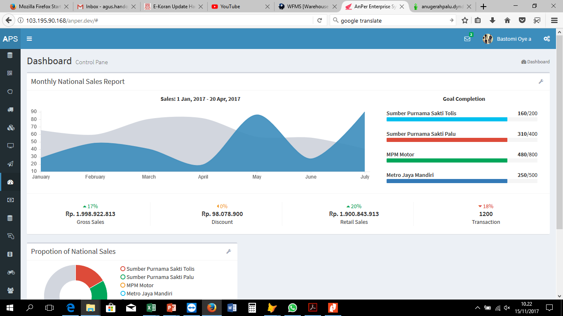






Dasboard Wall depan : Warehouse
Jakarta
Palu
Surabaya

Slide 9

Dasboard Wall depan : Warehouse
Jakarta
Palu
Surabaya

Slide 10

Dasboard Wall depan : Warehouse
Jakarta
Palu
Surabaya

Slide 11

Dasboard Wall depan : Warehouse
Jakarta
Palu
Surabaya

Slide 12

Dasboard Wall depan : Warehouse
Jakarta
Palu
Surabaya

Slide 13
Dasboard Wall depan : Warehouse
Jakarta
Palu
Surabaya

Slide 14
Selesai
AP
Accounting & Audit Division
February2017
Notes:
You can safely remove this slide. This slide design was provided by SlideModel.com – You can download more templates, shapes and elements for PowerPoint from http://slidemodel.com

